Slide 1
Vector Space Model
07-02-2023

Slide 2
Introduction Vector Space Model(VSM)
It goes without saying that in general a search engine responds to a given query with a ranked list of relevant documents.

Slide 3
Purpose of Vector Space Model(VSM)
The purpose of this approach to finding relevant documents with respect to a given query.

Slide 4
VSM Score Computing Factors
In the Vector Space Model (VSM), each document or query is a N-dimensional vector where N is the number of distinct terms over all the documents and queries.
The i-th index of a vector contains the score of the i-th term for that vector.

Slide 5
SCORE Function of VSM
The main score functions are based on:
Term-Frequency (tf)
Inverse-Document-Frequency(idf).

Slide 6

Term Frequency Computation Formula
where n_{kj} are the occurrences of the i-th term in the j-th document.

Slide 7
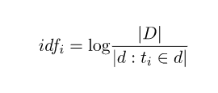
Inverse-Document-Frequency

Slide 8
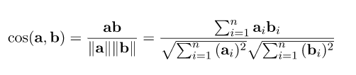
Cosine Similarity
In order to compute the similarity between two vectors
This formula computes the cosine of the angle described by the two normalized vectors : if the vectors are close, the angle is small and the relevance is high

Slide 9
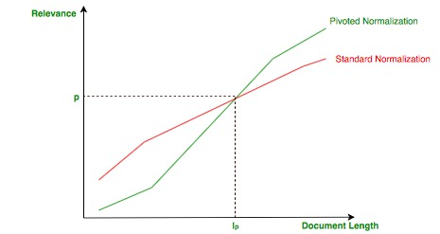
Pivoted Normalization: Shorter document than empirical value

Slide 10
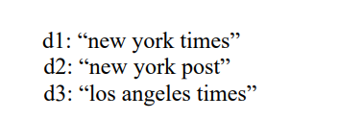
EXAMPLE

Slide 11
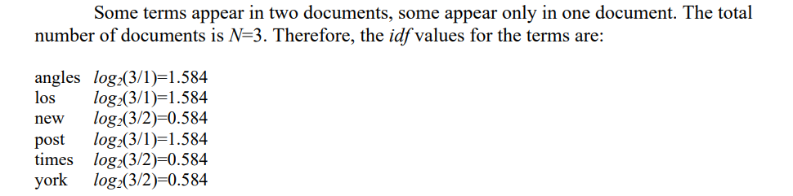
Computation of VSM

Slide 12
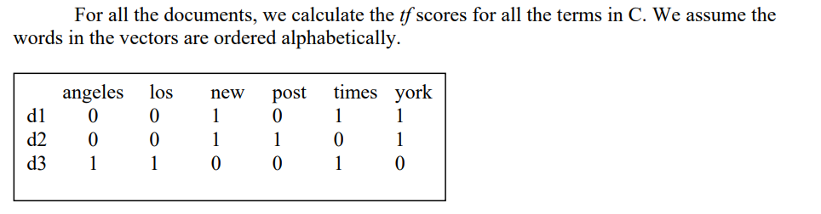

Slide 13
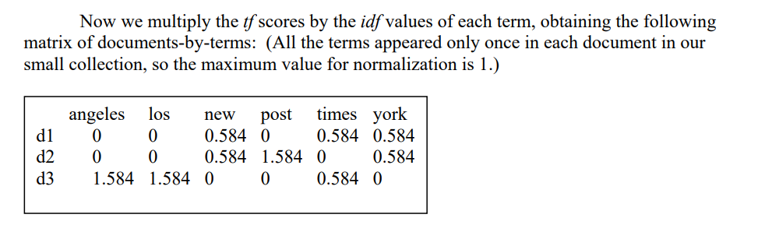

Slide 14
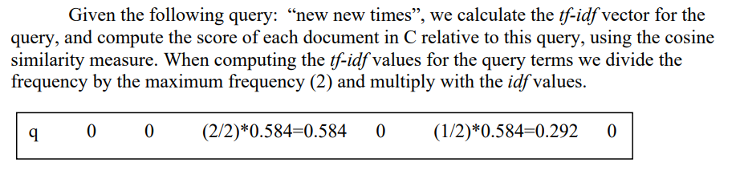

Slide 15
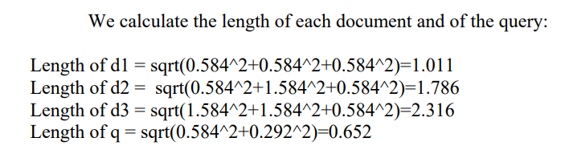

Slide 16
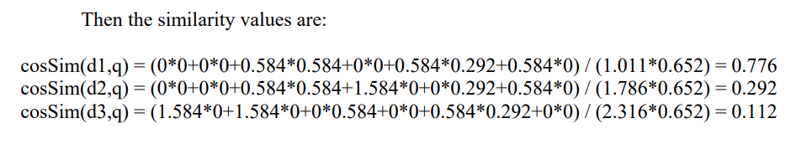
According to the similarity values, the final order in which the documents are presented as result to the query will be: d1, d2, d3.

